Slide 1


K.RAMAKRISHNAN COLLEGE OF TECHNOLOGY
(AUTONOMOUS), TRICHY.
GUESS THE NUMBER GAME
SUPERVISOR
Mr. M. Saravanan, M.E.,
AP/CSE.
PRESENTED
Hari Priya .E
2303811710422050

Slide 2
PRESENTATION OVERVIEW
Objective
Project Introduction
Problem Statement
Methodologies
Architecture of the proposed system
List of Modules
Merits
Results and Discussion
Queries

Slide 3
OBJECTIVE
The primary objective of this project is to develop a user-friendly and interactive "Guess the Number" game using Java and Swing. The game allows users to guess a randomly generated number within a defined range.
The game offers feedback after each guess, such as "Too High" or "Too Low," and provides the user with a limited number of attempts. By incorporating a difficulty selection, players can adjust the challenge of the game based on their preferences.

Slide 4
PROJECT INTRODUCTION
The "Guess the Number" game is a classic number-guessing game that has been implemented with a graphical user interface (GUI) using Java Swing. In this game, a random number is selected within a specified range, and the player must guess that number within a limited number of attempts.
The game presents an opportunity for users to engage in a fun and intellectually stimulating activity while improving their decision-making skills. The game allows for customization through different difficulty levels, giving users the ability to tailor the game according to their skills.
The use of Java Swing ensures a responsive and interactive experience, with the user interface displaying real-time updates and feedback on the player's guesses.

Slide 5
PROBLEM STATEMENT
This project aims to create a simple yet interactive number-guessing game where players try to guess a random number generated within a range. The game includes feedback for each guess, indicating whether the guess is "Too Low" or "Too High," and offers a success or failure message based on whether the player guesses correctly within the specified attempts.
The user can choose the difficulty level, which adjusts the range of numbers and the number of attempts allowed. The game concludes when the user either guesses the correct number or exhausts the available attempts.

Slide 6
METHODOLOGIES
1. GUI Development with Java Swing:
The game uses Swing components like JFrame, JLabel, JTextField, and JButton to create a graphical user interface (GUI) that enables user interaction.
2. Event Handling with ActionListener:
The game relies on the ActionListener interface to capture user actions (e.g., clicking a button), which triggers appropriate responses like processing the guess.
3. Conditional Logic (if-else statements):
The program uses if-else statements to check the user's input and provide feedback such as whether the guess is "Too Low" or "Too High."

Slide 7
METHODOLOGIES
4. Random Number Generation:
Java's Math.random() method is used to generate a random number within a specified range that the user has to guess.
5. Event Handling with ActionListener :
To ensure the program doesn't crash, the game handles invalid inputs (such as non-numeric entries) using try-catch blocks, prompting the user to enter a valid number.
6. Conditional Logic (if-else statement):
Based on the selected diff iculty level (Easy, Medium, Hard), the game dynamically changes the number range and the number of attempts allowed, making it adaptable to different skill levels.

Slide 8
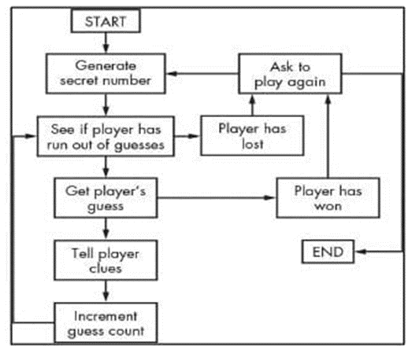
ARCHITECTURE OF THE PROPOSED SYSTEM

Slide 9
LIST OF MODULES
1. Java Swing GUI Components:
The "Guess the Number Game" uses Java Swing components to create an interactive GUI. JFrame acts as the main window container, while JLabel displays instructions and feedback to the player. JTextField allows the player to input guesses, and JButton facilitates actions like submitting guesses, restarting the game, and exiting. JOptionPane is used for difficulty level selection via a pop-up dialog. Together, these components create a user-friendly and visually appealing interface.
2. Event Handling:
Event handling is managed using ActionListener to dynamically respond to user actions, such as button clicks. This allows the game to process guesses or initiate a new session in real-time. The event-driven model makes the game intuitive and interactive, and using action listeners for specific buttons improves code organization and maintainability.

Slide 10
LIST OF MODULES
3. Logic Control:
The game uses random number generation via Math.random() to introduce unpredictability and keep the game challenging. Input validation with try-catch blocks ensures the game doesn't crash due to invalid inputs, providing users with meaningful feedback rather than terminating unexpectedly.
4. Game Logic:
The core of the game compares the player’s guess to the randomly generated number using if-else statements, offering immediate feedback on whether the guess is too high, too low, or correct. .

Slide 11
LIST OF MODULES
5. Game State Tracking:
Game state tracking manages the player's progress by keeping track of the randomly generated number, the number of attempts, and the difficulty level. Variables are updated during gameplay to provide real-time feedback. The startNewGame() method resets the state for a new session, ensuring smooth gameplay and maintaining code clarity and functionality.

Slide 12
MERITS
Interactive Experience: Provides a fun and engaging way to challenge logical reasoning and estimation skills.
Customizable Difficulty: Accommodates players of all skill levels by offering multiple difficulty modes.
Error Handling: Prevents invalid inputs and enhances the user experience by guiding the player with meaningful feedback.
Dynamic Gameplay: Adjusts the game based on the diffculty level, maintaining excitement and challenge.
Educational Value: Demonstrates core Java programming concepts, including GUI development, event-driven programming, and exception handling.

Slide 13
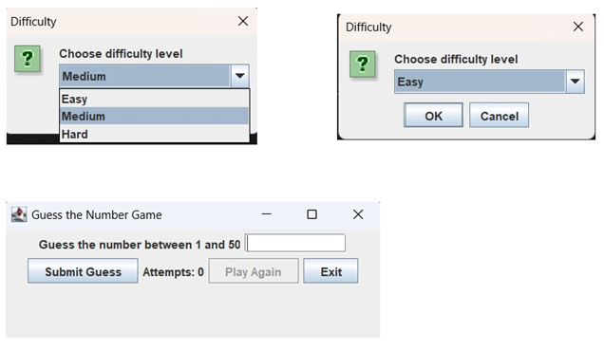
RESULTS AND DISCUSSION

Slide 14
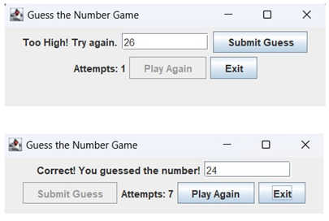
RESULTS AND DISCUSSION

Slide 15
QUERIES ?

